Slide 1
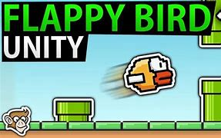
Team Members
Cijin Joseph John
Aiswarya Lekshmi
Ashna Jamal
Archa Harikumar H

Slide 2
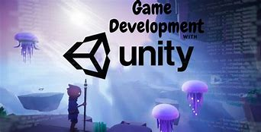
Abstract
Our project is based on game development and we created a flappy bird game using unity engine.We used C# language for doing the coding part.

Slide 3
Introductory Overview
Flappy Bird is an arcade-style game in which the player controls the bird , which moves persistently to the right. The player is tasked with navigating bird throughthe pillers that have equally sized gaps placed at random heights. Bird automatically descends and only ascends when the player taps the touchscreen. Each successful pass through a pillar awards the player one point. Colliding with a pillar or the ground ends the gameplay and the end score will be displayed on the screen.

Slide 4
Objectives
To gain better knowledge on game development.
To get familarised with the unity engine.
To develop creativity and individuality in problem solving and performing tasks.
To promote team work.
To improve skills.

Slide 5
Literature Review
We referred youtube tutorials of unity.
We have referred various websites to get better knowledge on C# language which we have used for the coding part.
Our mentor Shaino,guided us a lot in doing our project and taught us the basics of game development.

Slide 6

Engineering Techniques
We have used unity engine in developing our project.Unity is a cross-platform game engine developed by Unity Technologies, first announced and released in June 2005. The engine supports a variety of desktop, mobile, console and virtual reality platforms. It is particularly popular for iOS and Android mobile game development and used for games such as Pokémon Go.It is cited to be easy to use for beginner developers.We created the project in 2D.

Slide 7
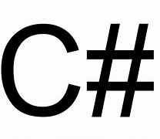
The language used in unity is C#.C# (pronounced "See Sharp") is a modern, object-oriented, and type-safe programming language. C# enables developers to build many types of secure and robust applications that run in .Net.C# language has its roots in C programming language.

Slide 8
Timeline
The group was formed on 02 September 2021 .
We started doing our project from 3rd September onwards.
We completed it by 28th September 2021.

Slide 9
Methodology
Download and install unity through unity hub .
Project setup: Start unity hub and select new and name the project as flappy bird.Select 2D and create project.
After unity hub have created the project.We have attached the images of bird,sky and ground into a newly created folder named sprites and dragged it to assets.
We dragged from project tab to Hierarchy and made sky as child of ground.
Then set positions of each of them correctly.

Slide 10
Ground Physics:The ground should the part of the physics world. Right now it is really just an image in the game world, just a visual effect and nothing more. We want the ground to be like a wall that the bird can collide with, so let's select Add Component -> Physics 2D -> Box Collider 2D in the Inspector.
Bird Physics:Select Add Component -> Physics 2D -> Rigidbody 2D .

Slide 11
Add layers.
Bird:Select Bird. select Multiple as Sprite Mode. Afterwards, click Apply. Then we click the Sprite Editor button then we Slice the bird image and apply.
Adding Scripts:Making sure the Bird object is selected in the Hierarchy, select Add Component -> New Script in the Inspector, name it Bird click Create. We will also create a new Scripts folder in our Project Area so that we can put the Bird Script into it.If we save the Script and press Play then we can see how the bird flies towards the right of the Screen.

Slide 12
Create a UI text by clicking the hierarchy tab and name it as scoretext and set the alignment as bottom centerand set the text as Scre 0 and again create another UI and name it as GameOverText and set its text as Game Over and create another UI named Scoretext1 and set its text as Tap to restart.
Create an empty Gameobject and name it as GameController .
Go to inspector tab and click on add component and add new Script named gameControl and save it.
Now the gameover & tap to restart text will display on the screen when the bird collides with the ground.

Slide 13
Animation:Select bird and click on window and add animation and click on create and name the file as idle and make a new folder known as animation and save it .Add property and click on sprite .Click on new clip and name it as flap and drag bird from project tab to sprite under sprite renderer in the inspector tab and again slect a new clip and name it as die and drag it to sprite and follow the same procedures.
Add obstacle such as pillar and apply the obstacle physics 2D to it.
Play the Game.

Slide 14
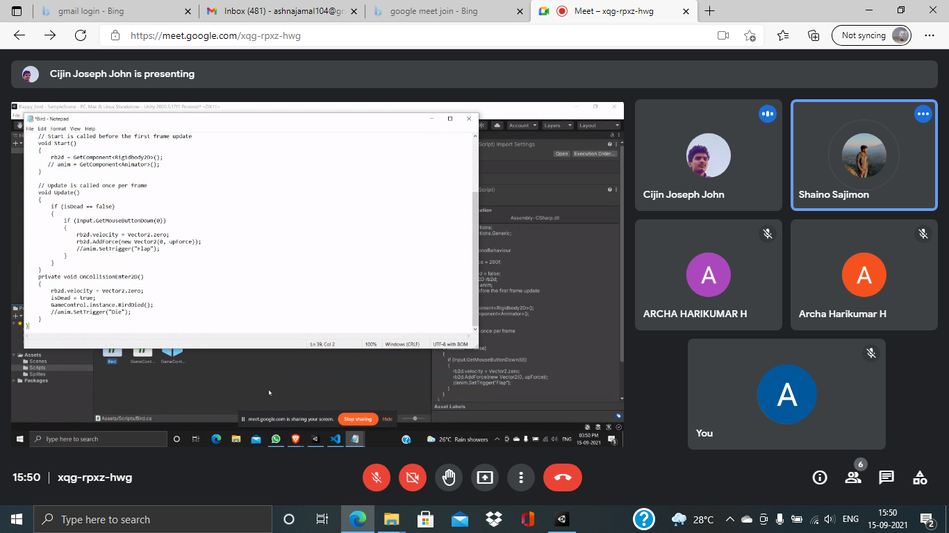
Diagrams and illustrations

Slide 15
Result and Conclusion
The project has been completed successfully .
We faced certain issues while downloading and installing unity hub.
We also faced many errors while doing the coding part and at some point of time certain components of the game was not working as expected.

Slide 16
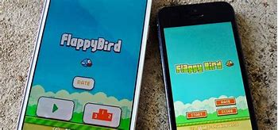
Future Scope
In the future we need to add levels inorder to make the game much more interesting.
We wish to develop it as a game application which works on android .

